Slide 1

UNIVERSITY INSTITUTE OF TECHNOLOGY RGPV,BHOPAL(M.P)
Emotion based music recommender system
Presented by :
diksha Gupta
Enroll no. 0101ca211019
Alka Tiwari
Enroll no. 0101ca211006
Anjali kohre
Enroll no. 0101ca211009
SUBMITTED TO :
ATUL PANDEY
ANJANA PATNEY
JAY NARAYAN

Slide 2
CONTENT
INTRODUCTION
SOFTWERE USED
METHODOLOGY
FLOW DIAGRAM
WORKING
FUTURE SCOPE
CONCLUSION

Slide 3
introduction
In this concept music is recommended to the user by detecting the real time capturing of user’s emotions.
Emotion-Based-music-player It’s Based on the detected user’s mood song list will be displayed/recommend to the user.
In this application image of a person is captured using a real time machine that has the access to the local machinery and depending on the captured image it compares the database data sets that already saved in the local device through processing it defines the present mood of the user in numerical form based on this music will be played.

Slide 4
Software used:
Language used: python
Ide : vs code
Libraries used : open cv, mediapipe, numpy, streamlit, os, streamlit-webrtc

Slide 5
METHODOLOGY:
FACE CAPTURING :
The main objective is to capture images so here we are using the common device i.e, webcam . for that purpose we are using the open CV library.
so, in the initial phase of this project in order to capture the images and face detection. This project uses mediapipe for the key point extraction .
The key point of face , left and right hand are extracted using mediapipe then these key points are collected and saved as numpy file.

Slide 6
MUSIC RECOMMENDATION:
The input images that is acquired is from the web camera and is used to capture real-time images.
here we have four main emotions because it is very hard to define all the emotions and by using limited options it can help the compilation time and the outcome is more sophisticated.
open cv and streamlit is used to create webapp. For capturing the webcam in the browser we used streamlit-webrtc module. . The song’s will be played from the detected emotion.

Slide 7
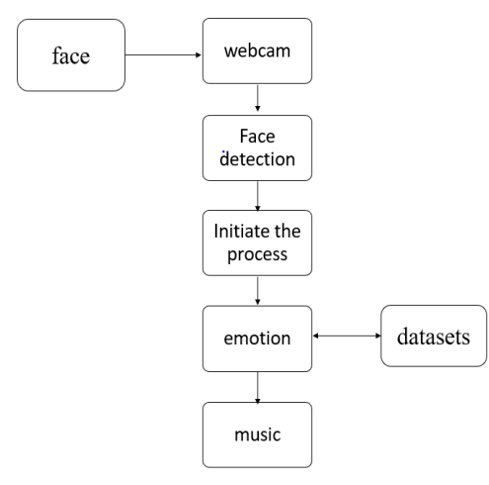
Flow diagram

Slide 8
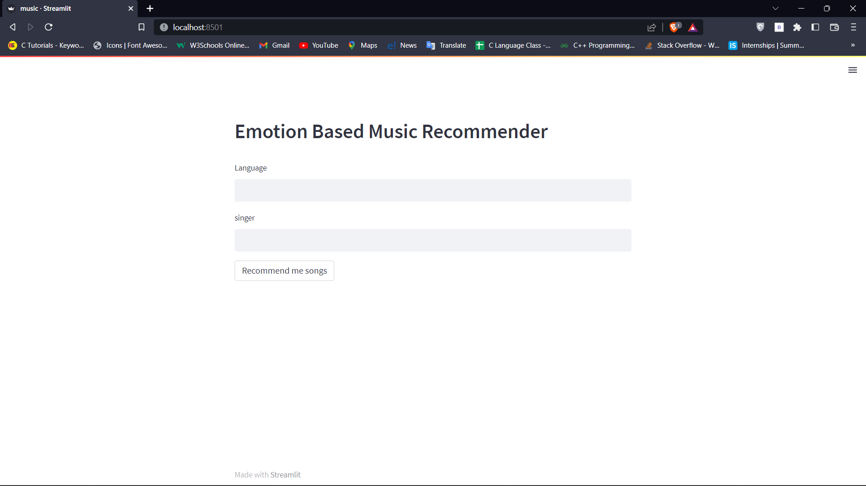

Slide 9
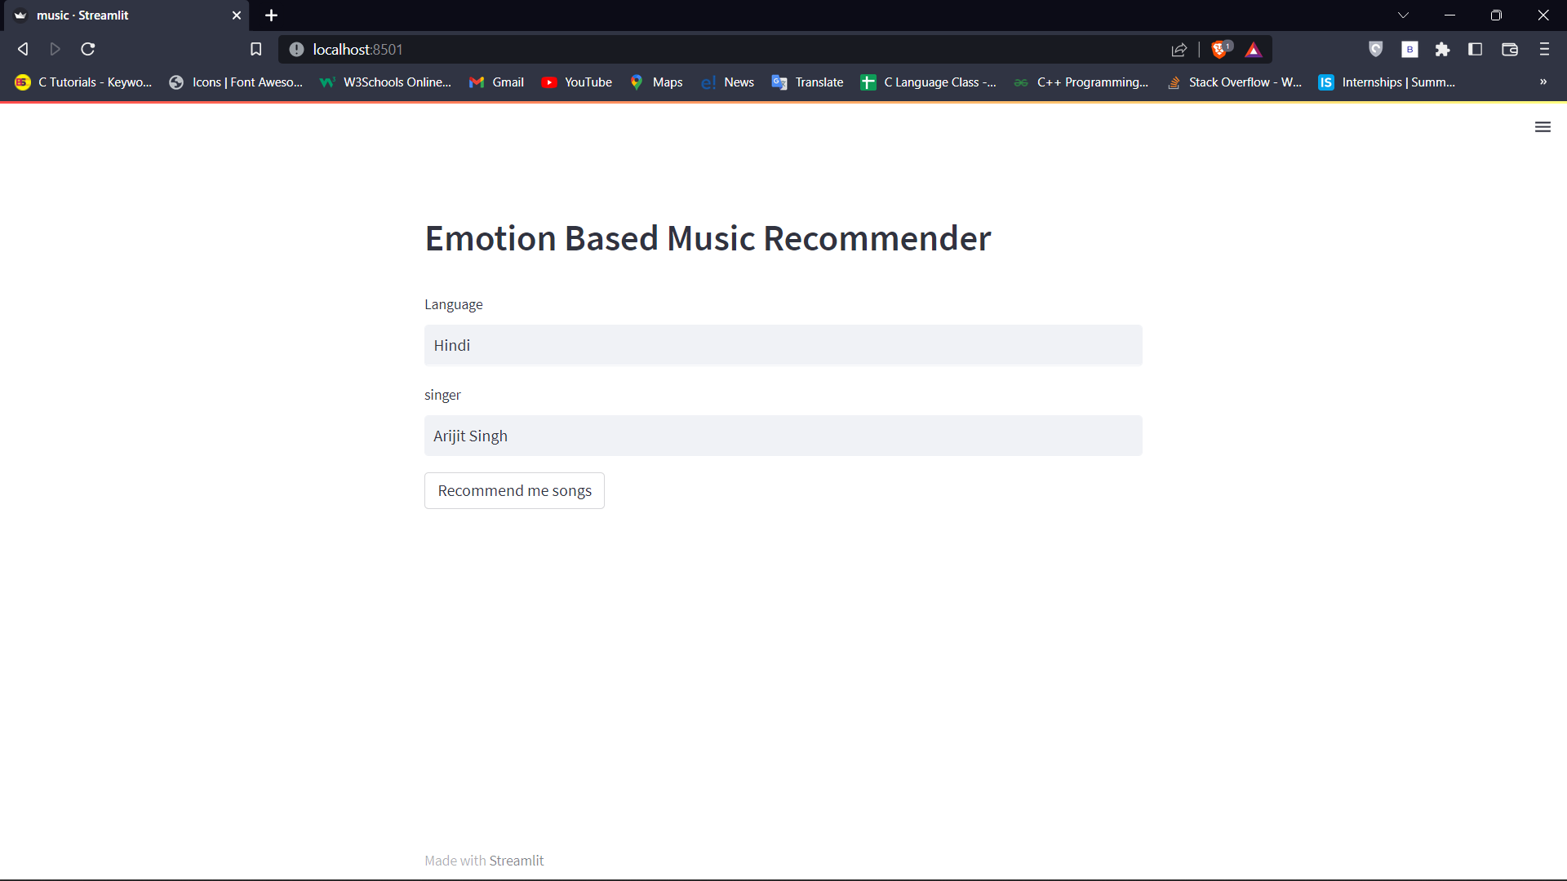

Slide 10
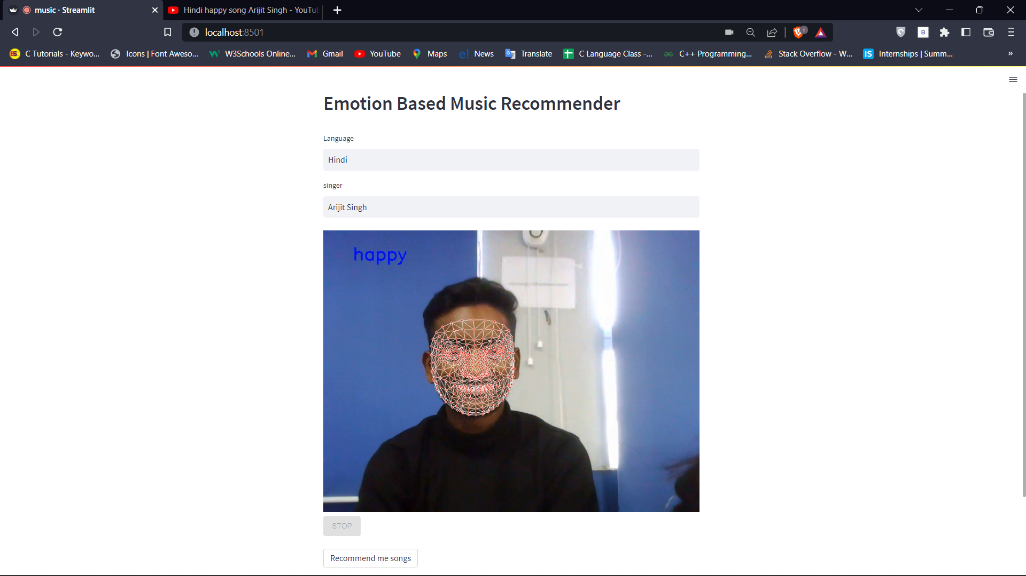

Slide 11
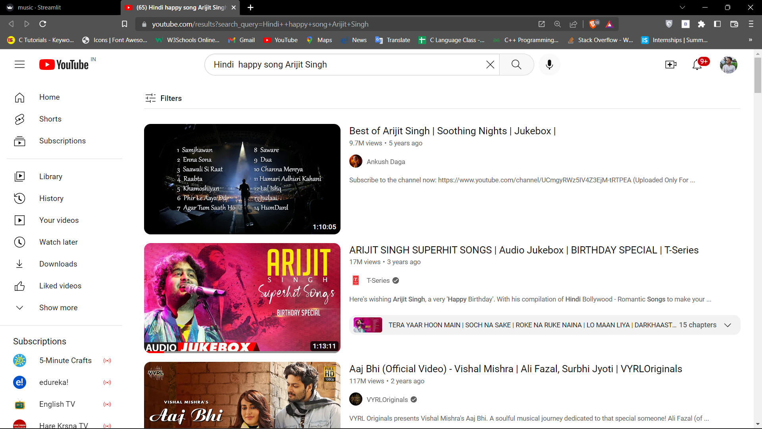

Slide 12
FUTURE SCOPE:
The future scope in the system would to design a mechanism that would be helpful in music therapy treatment and provide the music therapist the help needed to treat the patient suffering from disorder like mental stress, anxiety, depression and trauma.

Slide 13
CONCLUSION:
In this project , music recommendation model it is based on the emotions that are captured in real time images of the user. This project is designed for the purpose of making better interaction between the music system and the user. because Music is helpful in changing the mood of the user and and for some people it is a stress reliever.

Slide 14
Thank you

